Slide 1
MACHINE LEARNING METHODS TO SURVEY VOCAL VARIETY IN A SUBURBAN RESIDENT POPULATION OF MELOSPIZA MELODIA
VIDHUR PRABHU

Slide 2


Slide 3
SURVEY AND UNDERSTAND THE VOCAL VARIETY IN A SINGLE POPULATION OF SONG SPARROW

Slide 4
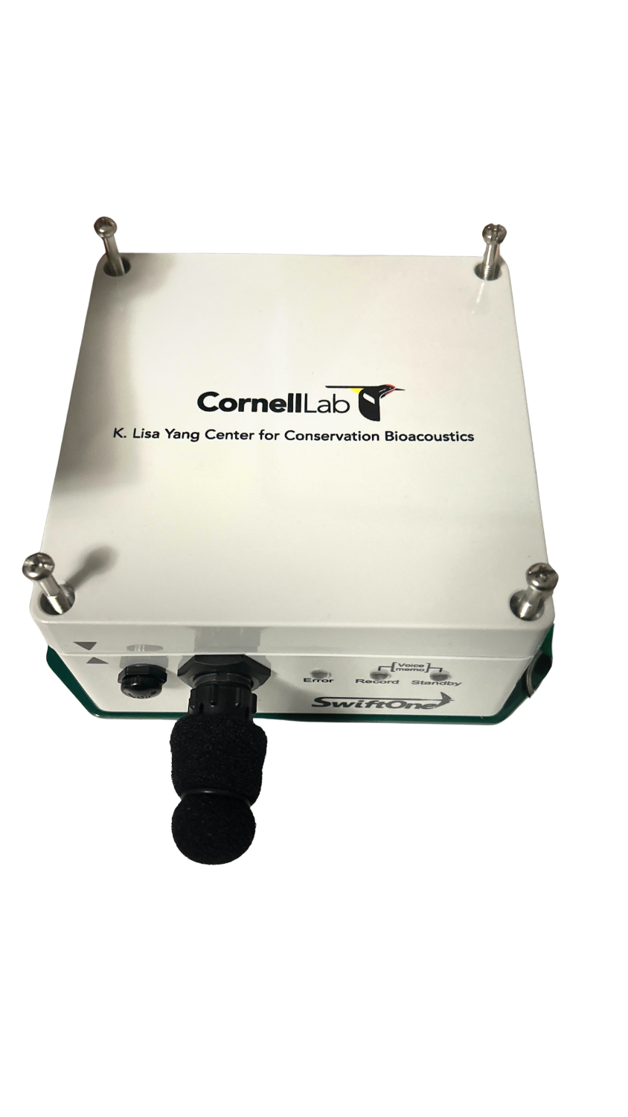

PASSIVE ACOUSTIC MONITORING
SWIFTONE: TERRESTRIAL AUTONOMOUS RECORDING UNIT
CONTINUOUS SCHEDULED RECORDING: 06:00 TO 20:00
RECORDINGS FROM 1/29 TO 3/21
  392 HOURS PROCESSED

Slide 5
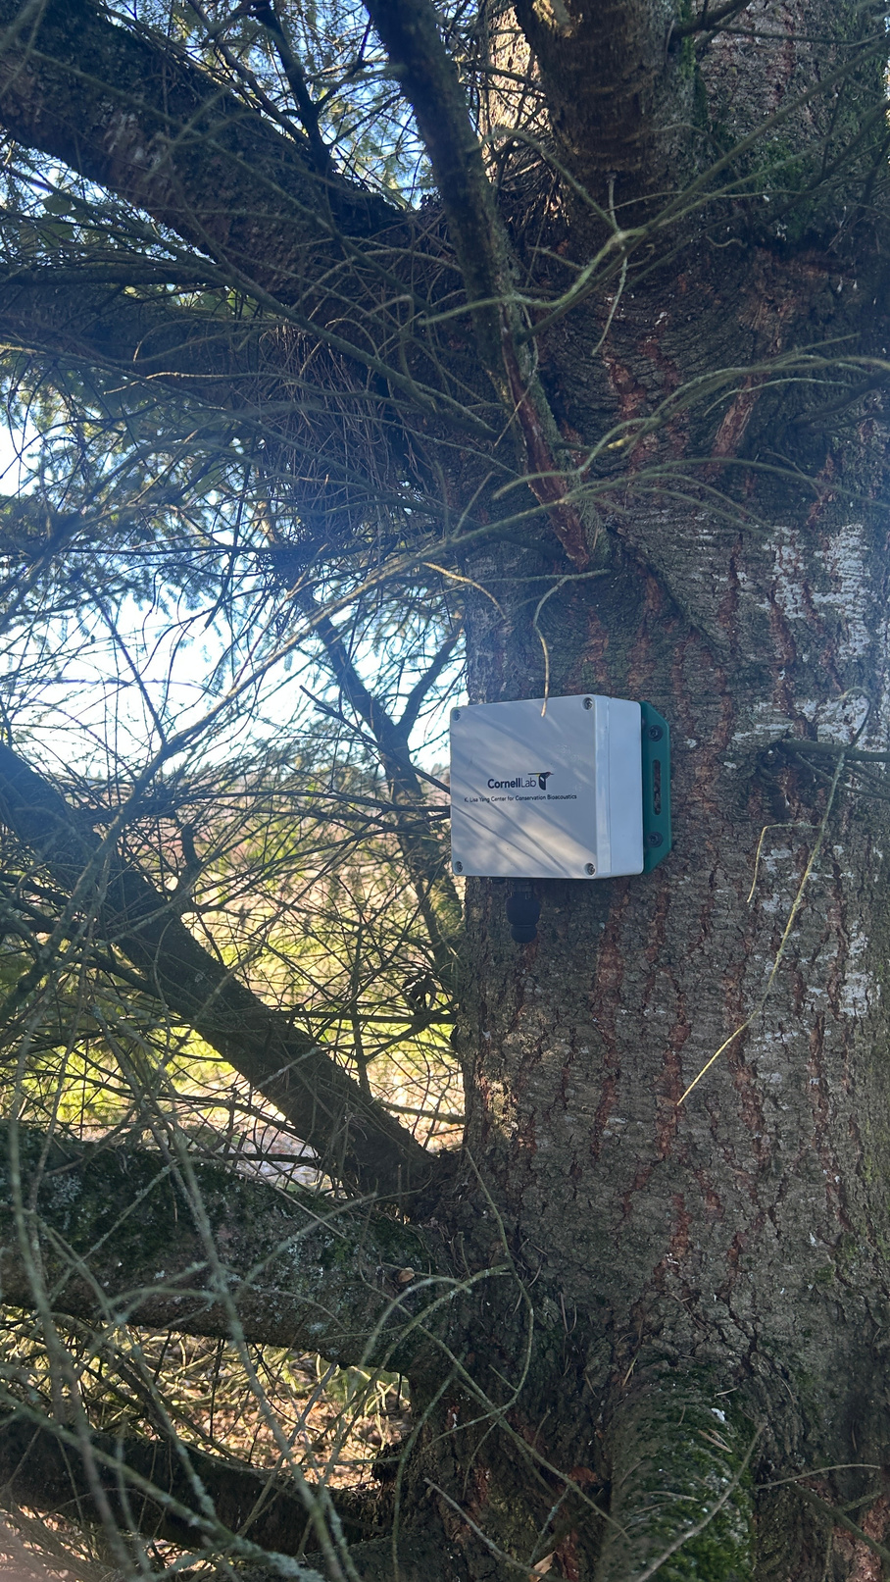
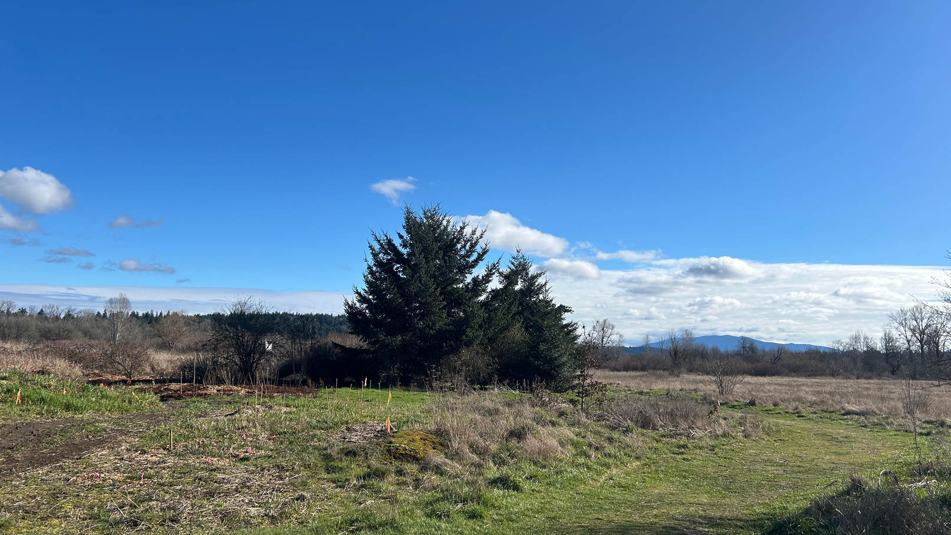
PASSIVE ACOUSTIC MONITORING

Slide 6
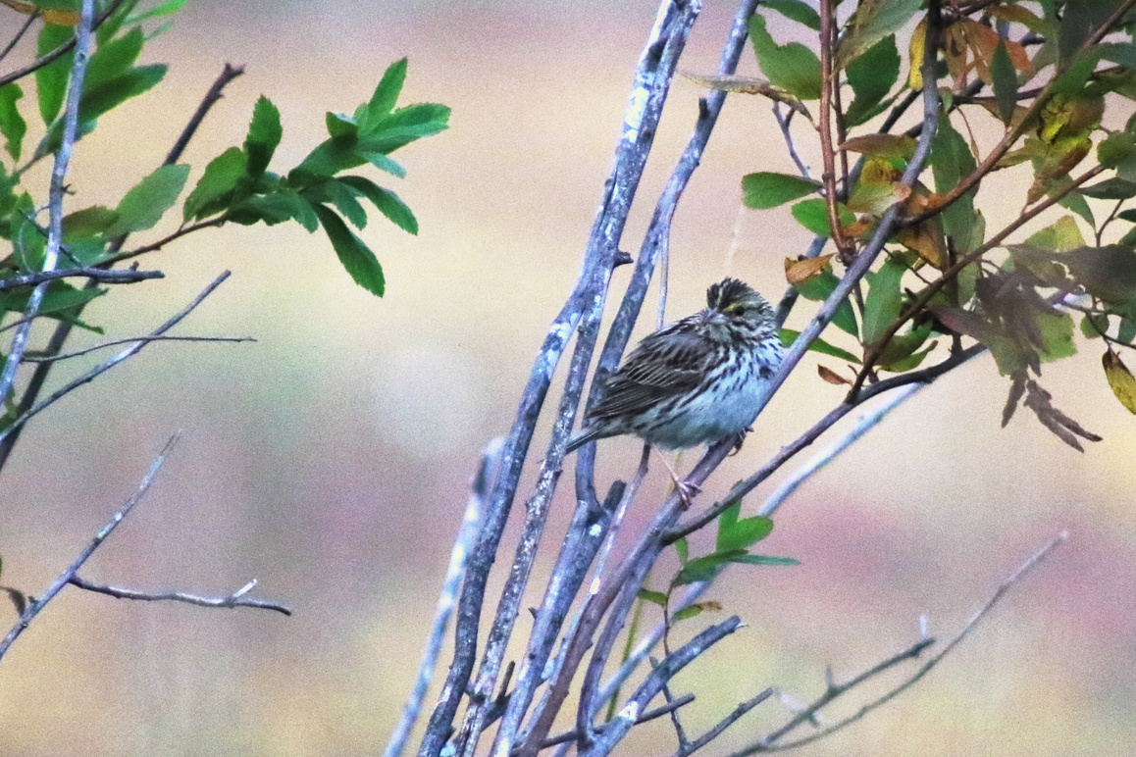

BIRDNET: SPECIES RECOGNITION
DEEP LEARNING BIOACOUSTICS SOFTWARE
IDENTIFIES BIRD SPECIES IN A GIVEN AUDIOFILE
OUTPUT: SPECIES, START/END, CONFIDENCE

Slide 7
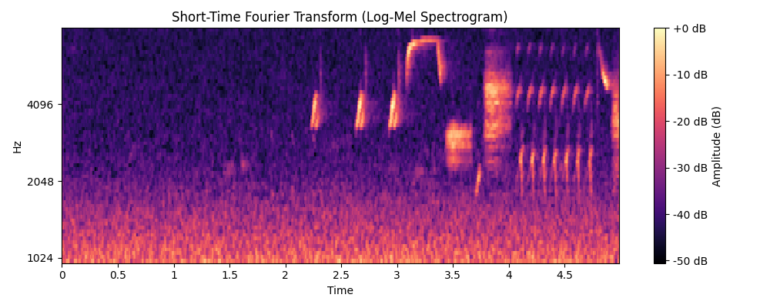
FEATURIZING AUDIO THROUGH STFT
SHORT-TIME FOURIER TRANSFORM: INTRODUCE FREQUENCY DIMENSION
SPECTROGRAM: TIME VS. FREQUENCY VS. AMPLITUDE

Slide 8
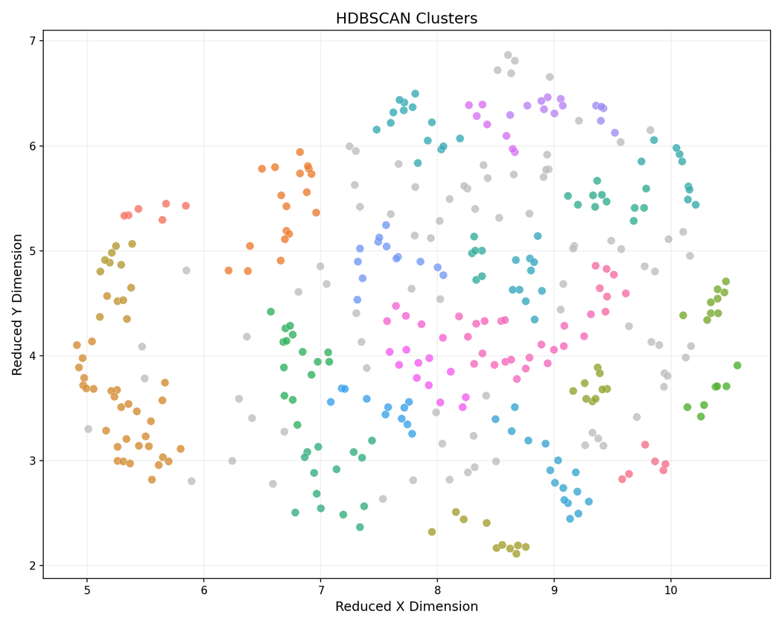
HDBSCAN
GOAL: FIND HIGHER-DENSITY CLUSTERS IN NOISY DATASET
NO PREDETERMINED K: NUMBER OF CLUSTERS
MEMBERSHIP CONFIDENCE: PROBABILITY

Slide 9
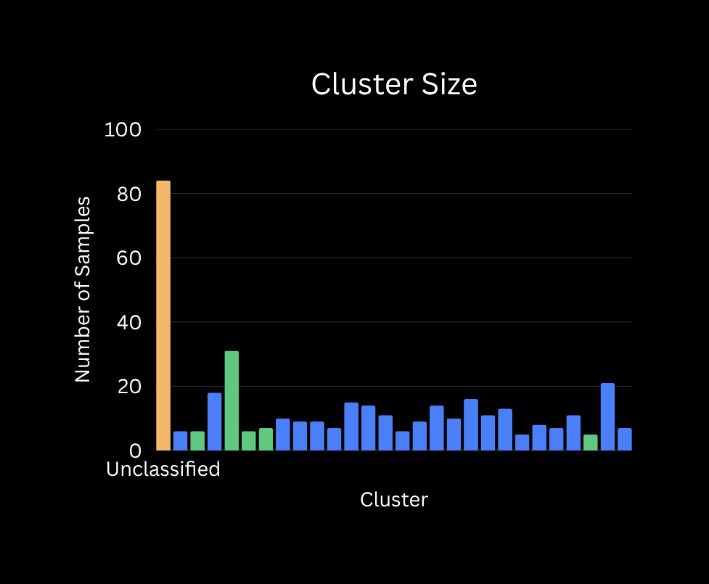
HDBSCAN RESULTS
IDENTIFIED 27 CLUSTERS (+1 UNCLASSIFIED)
22/27 CLUSTERS SHOW ‘CHIRP’ VOCALIZATION

Slide 10

MANUAL VERIFICATION
95.29% ACCURACY (CHIRP VS. SONG)

Slide 11
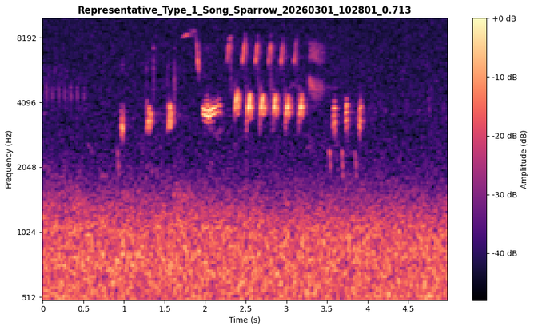
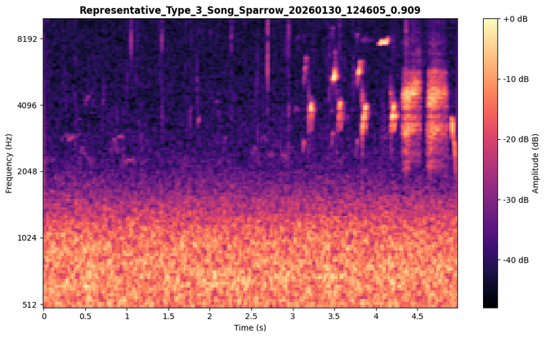
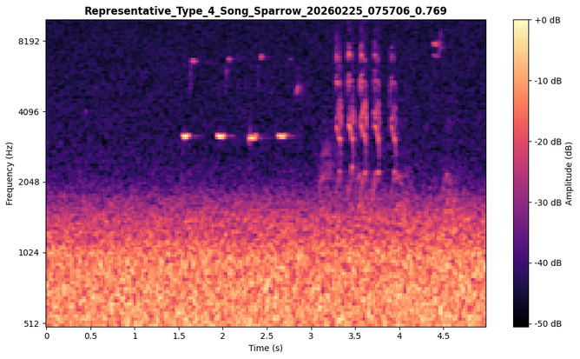
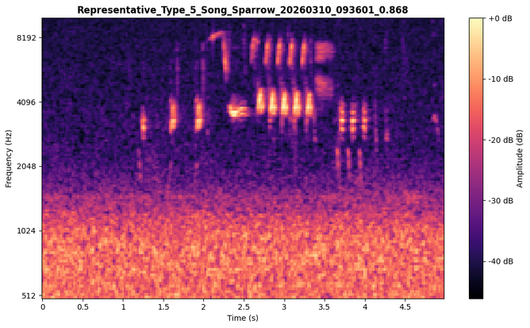
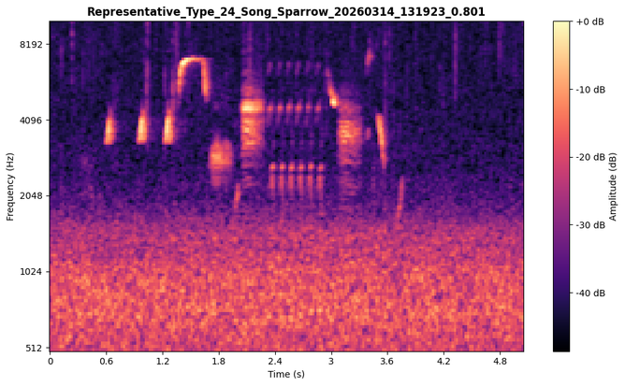
REPRESENTATIVE CLIPS

Slide 12
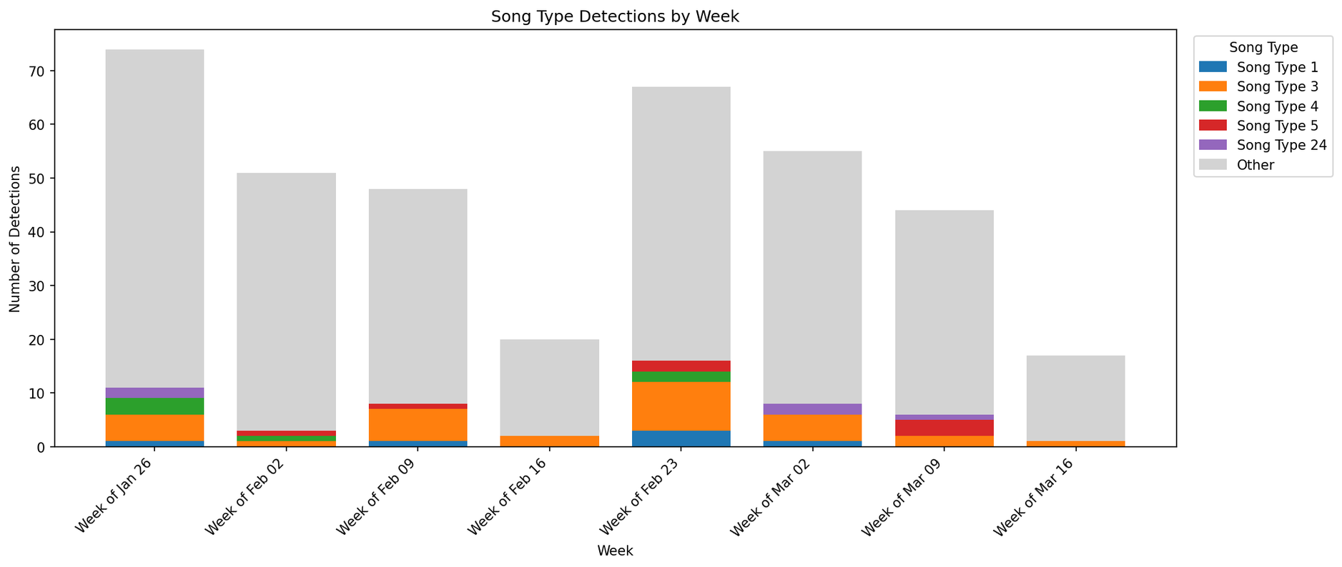
RECORDING PERIOD VARIANCE

Slide 13
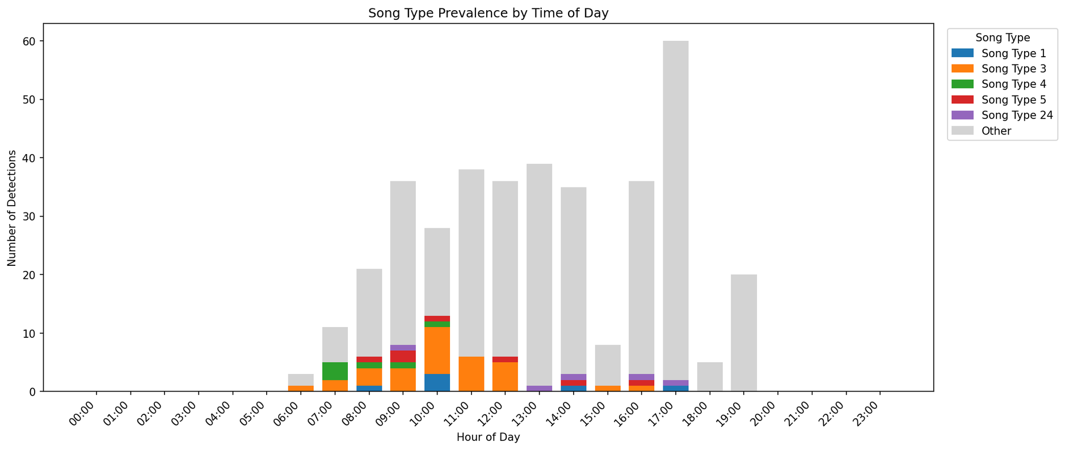
VOCALIZATIONS BY HOUR

Slide 14
SONG SPARROW VOCALIZATIONS ARE LARGELY HOMOGENOUS WITHIN A RESIDENT (WINTER) POPULATION
CHIRPS VARY SIGNIFICANTLY IN FREQUENCY AND SPEED WITHOUT PREFERENCE

Slide 15
MACHINE LEARNING PAIRED WITH PASSIVE ACOUSTIC MONITORING PROVIDES A USEFUL TOOL TO UNDERSTAND VOCALIZATIONS IN A SONGBIRD POPULATION

Slide 16
MONITOR CULTURE DIVERGENCE ACROSS POPULATIONS
TRACK VOCALIZATIONS AND SONG PREVALENCE ACROSS GENERATIONS
UNDERSTAND ECOSYSTEM HEALTH AND INTERSPECIES DYNAMICS
DELINEATE INDIVIDUAL TERRITORIES AND BOUNDARY SHIFTS

